Slide 1
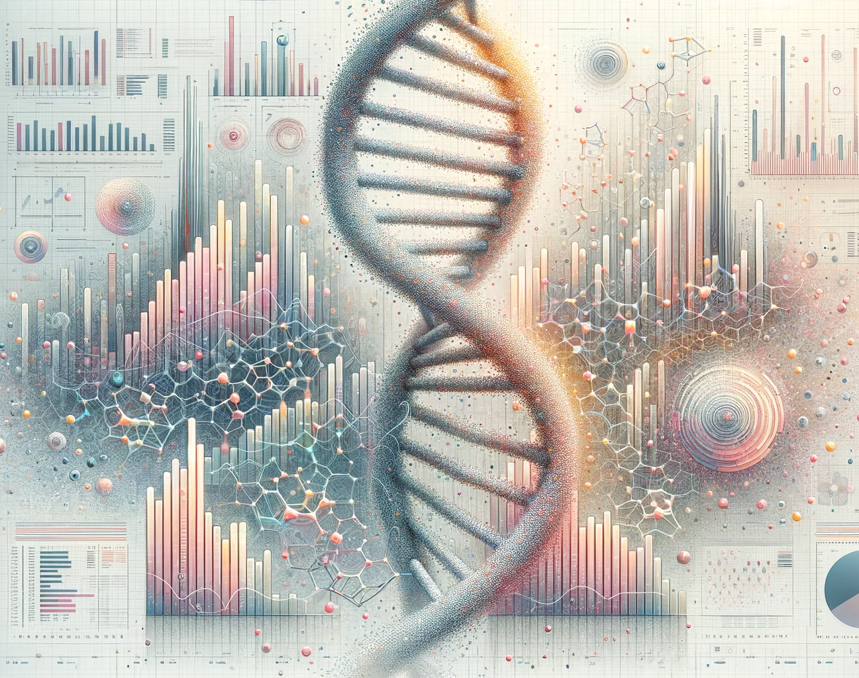

Mandriva
Software Development Group Project 2024
March 1st
Melika Abdi, Thomas Bennett, Niya Louis, Adam Brachtl

Slide 2
Requirements
Clustering analysis
Admixture analysis
SNP information retrieval
Pairwise population genetic differentiation matrix

Slide 3
Front-end Tools and Technologies
Flask
Build basic website without any complication.
HTML
Structure and functionality.
CSS
Define styles.
JavaScript
Selecting population and preventing conflict selections.
Bootstrap
Visually appealing web application.

Slide 4
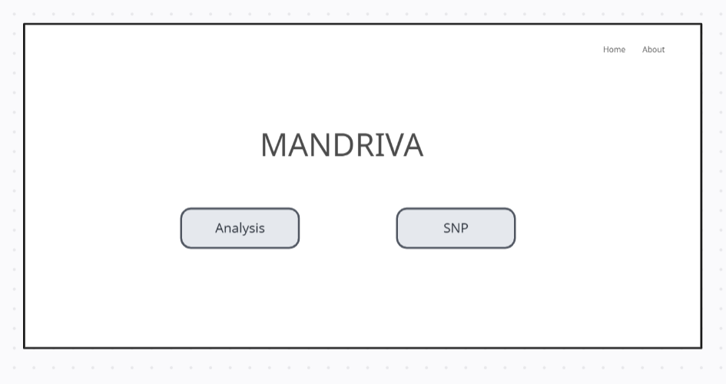
Initial Design
Home page

Slide 5
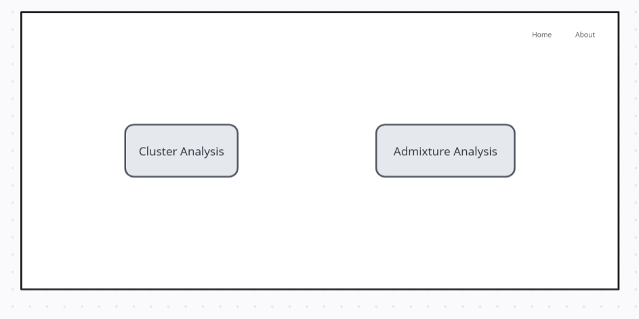
Initial Design
Analysis page

Slide 6
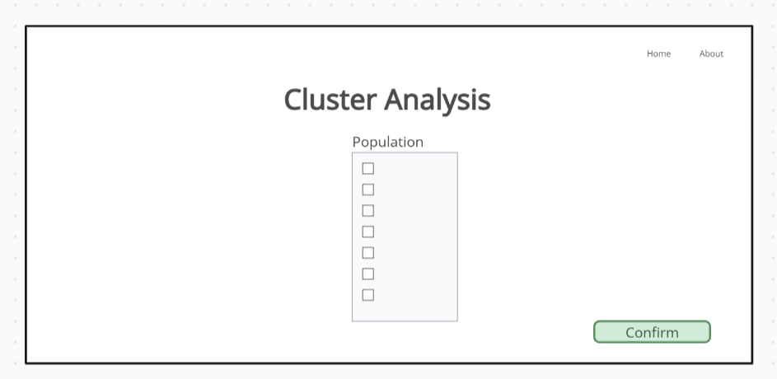
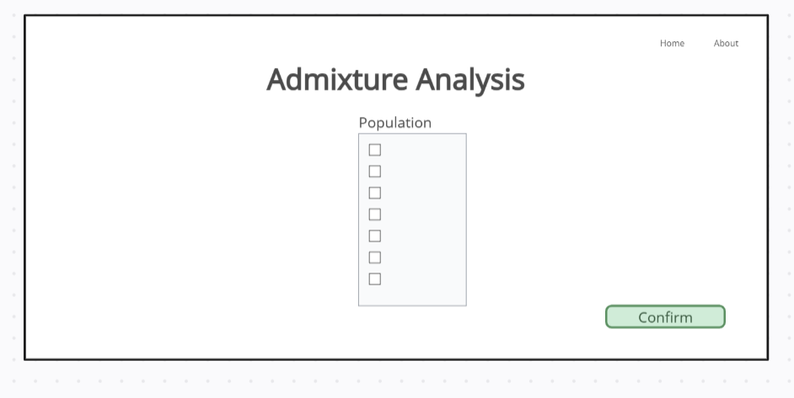
Initial Design
Clustering page
Admixture page

Slide 7
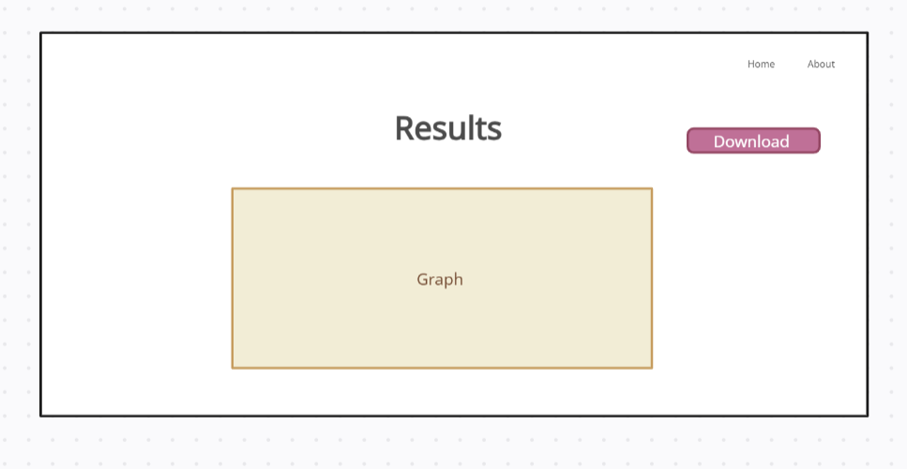
Initial Design
Analysis result page

Slide 8
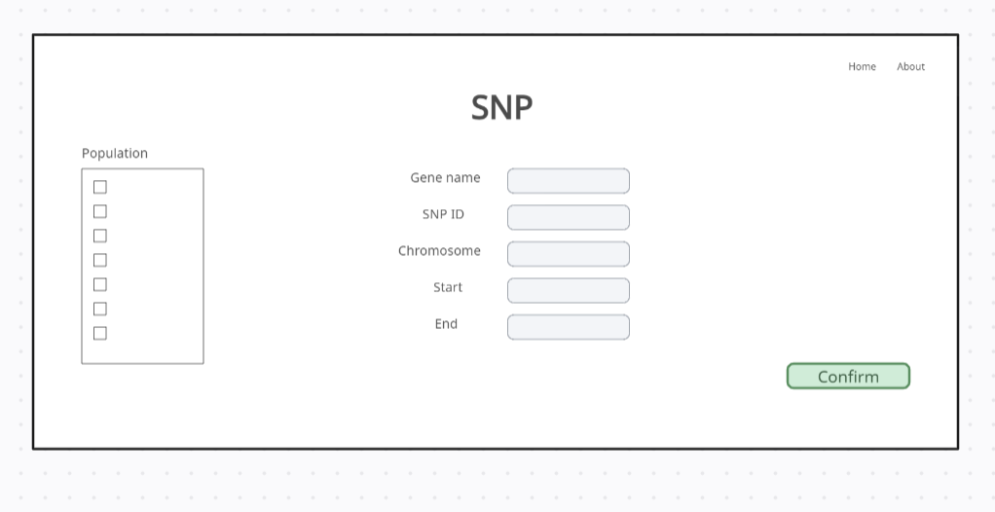
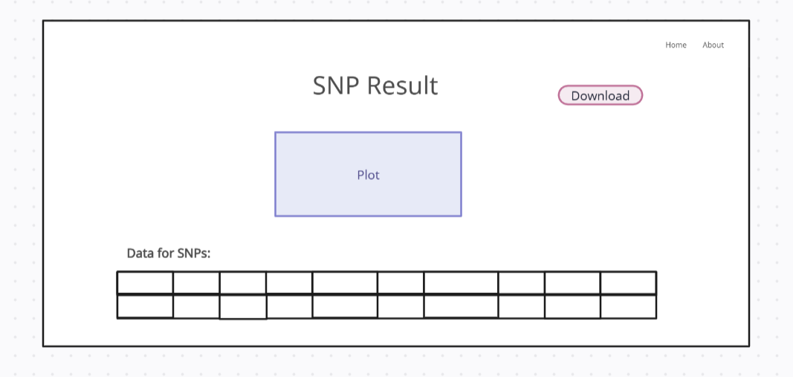
Initial Design
SNP page and results page

Slide 9
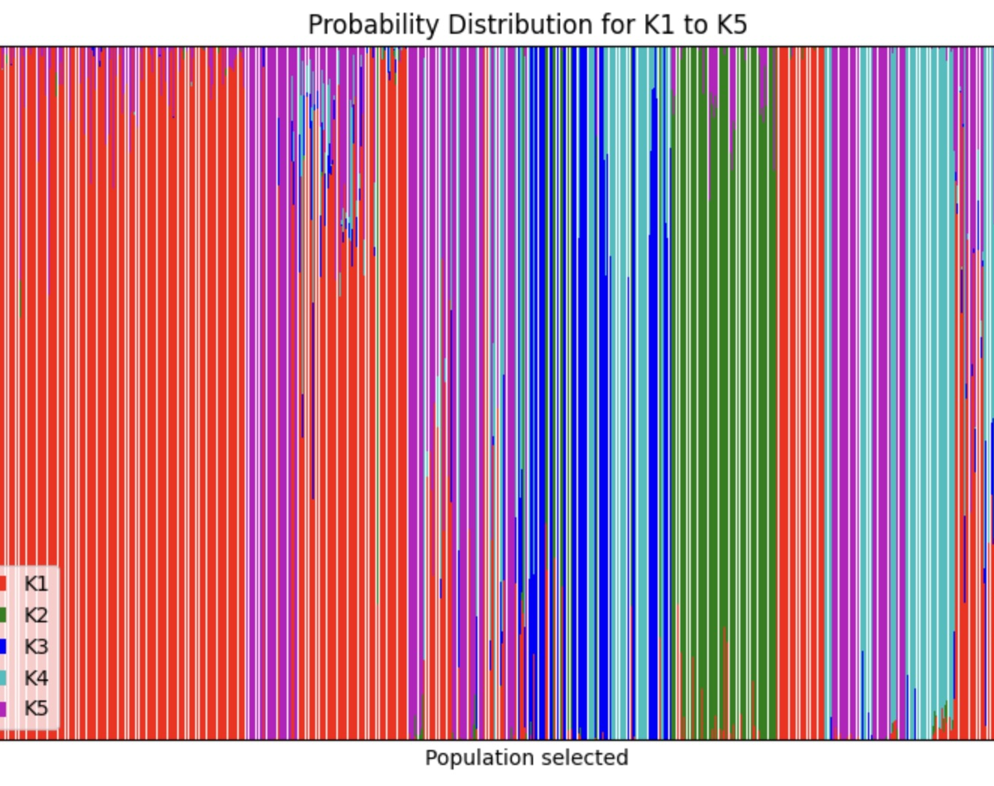
Admixture Analysis
Choice of K value
Cross-validation
Ancestral Proportion
Calculation on HPC and .Q File
Limitations

Slide 10
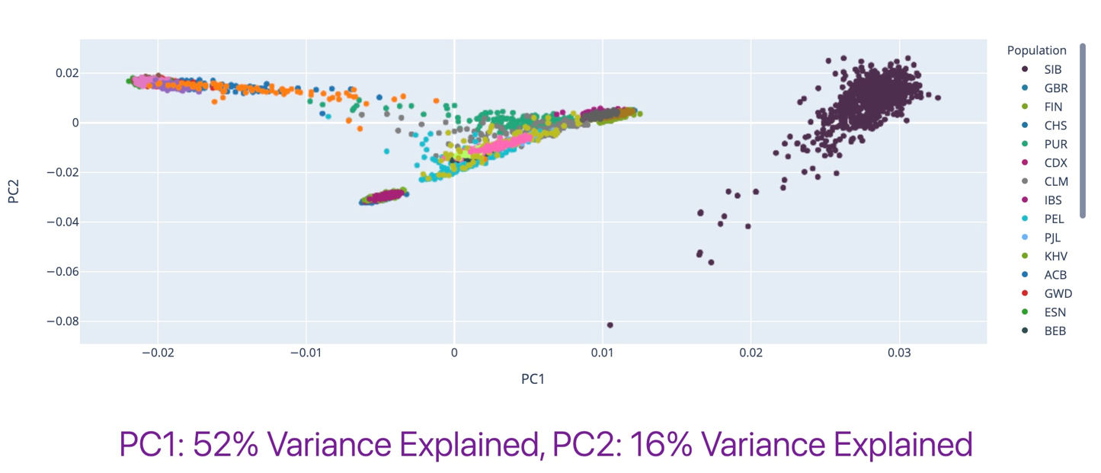
Cluster Analysis
PCA
Linkage Disequilibrium and pruning with PLINK
PCA Calculation
.eigenvec and .eigenval files

Slide 11
SNPs
SNP IDs
Original VCF file inconsistent variations like "1:10397:C:A" and others like "rs1557426847“
Output: VCF file
RS IDs
Annotation SNP VCF file from dbsnp VCF
Output: RS ID annotated VCF file
Genes
New annotated SNP ID VCF file linked with genes using VEP
Output: tab-delimited text file containing columns for SNP ID and corresponding genes
Clinical relevance
Annotation SNP VCF file from ClinVar VCF
Output: tab-delimited text file containing columns with SNP ID and an “extra” column containing clinical relevance, clinical disease name

Slide 12
Allele and genotype counts
Bcftools-27 sub-VCF files
Genotype counts
Loop employing PLINK
Output: tab-deliminated txt file with SNP IDs and counts for each population ("116,0,0")
Allele counts
Loop employing PLINK
Output: tab-deliminated txt file with SNP IDs and counts for each population ("72,0")
Notes:
In preparation to retrieve the genotype and allele counts, we used bcftools to create 27 sub-vcf files for each population.
For genotype counts a loop iterated through these sub-files employing PLINK to compute the genotype counts using the “—geno-counts” parameter. This produced individual population-specific files with columns for SNP IDs and counts for homozygous reference, heterozygotes, and homozygous alternate alleles. After this, another loop merge these counts into a single column for each population, these columns were stored in new text files which were merged in one file containing columns for each population with SNP IDs in the first column.
For allele counts, we used a similar approach. A loop went through the sub-VCF files, using PLINK to compute allele counts, similar to genotypes, this created population-specific files with SNP IDs and reference and alternate alleles. After that we combined these allele counts into a single column for each population, then again following the same procedure, these population specific columns were stored as a text file and merged into one file with columns for each population and SNP IDs as the first column.

Slide 13
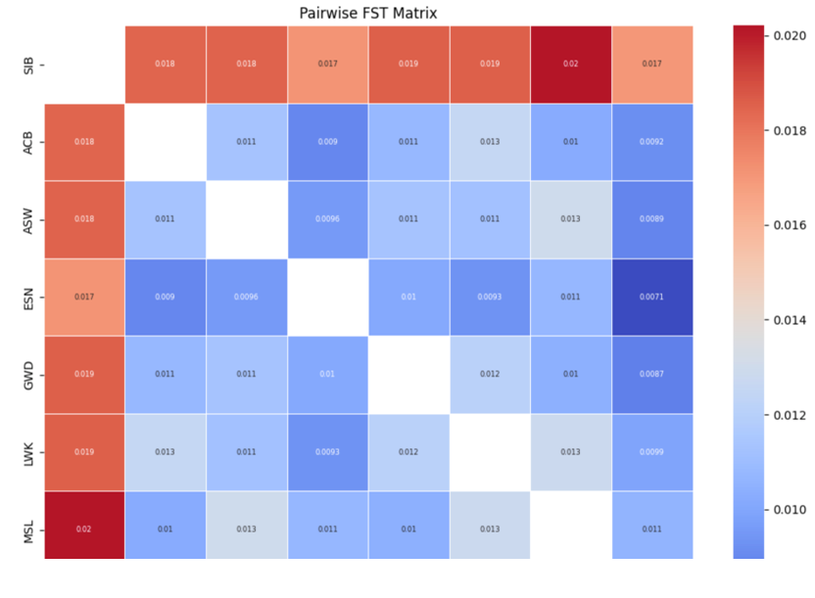
Pairwise FST genetic differentiation
Initial code in R
Complicated integration into Flask
GDS file complication
calculate_fst
calculate_fst_for_selection
calculate_pairwise_fst
Output: Pairwise FST matrix
Notes:
We created 3 functions calculate_fst which calculates the Fixation Index (FST) for a single Single Nucleotide Polymorphism (SNP) based on the counts of different genotypes and allele counts.
This function can be split into 4 main calculations: first computing the total count of homozygous reference, heterozygous, homozygous alternate, then calculating frequency of the reference allele, frequency of the alternate allele and finally the FST value for each SNP
Calculate_fst_for_selection which calculates FST values for a set of populations and a list of SNPs by querying genotype and allele counts from a SQLite database.
Calculate_pairwise_fst which calculates pairwise FST values between populations based on the FST matrix obtained from the previous function.

Slide 14
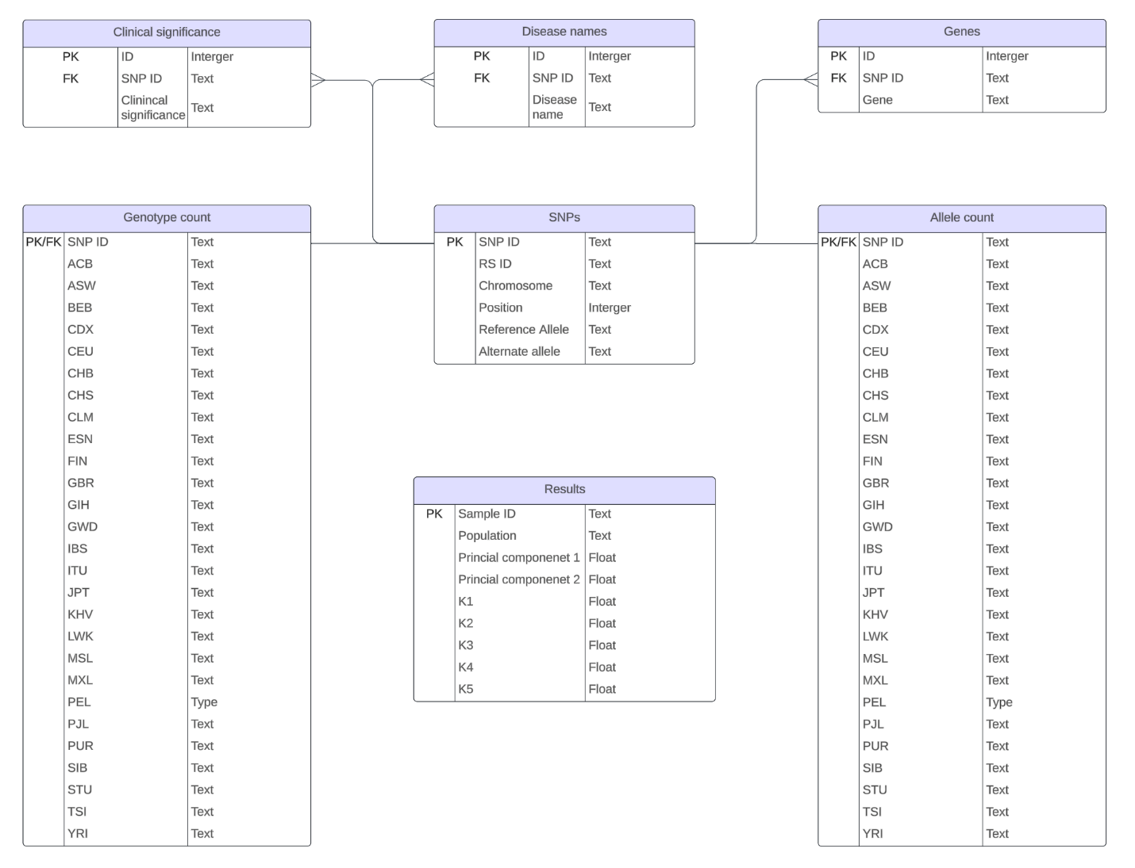
SQL
SQLite chosen
Lightweight
If scaled up
Other database engines could be used

Slide 15
Database population
SNPs table
CyVCF2 was used to extract information from the two VCFs
SNP ID-annotated VCF
RS ID-annotated VCF
Clinical relevance and clinical disease name tables
Regular expressions used to extract information from clinical VEP file

Slide 16
Database population
Results table
Combined the sample information, ADMIXTURE and first two components
.mode tabs to import
Genes table
.mode tabs to import VEP file
Allele count and Genotype count tables
.mode tabs to import the text files

Slide 17
Thank you for your attention!
Any Questions?​

